Slide 2
Build Amazing Cloud Connected Apps with Xamarin, Azure, and App Center
Matt Soucoup – Sr Cloud Advocate
@codemillmatt

Slide 3
Here Comes the Sun …
… WHAT WE’RE BUILDING TODAY

Slide 4
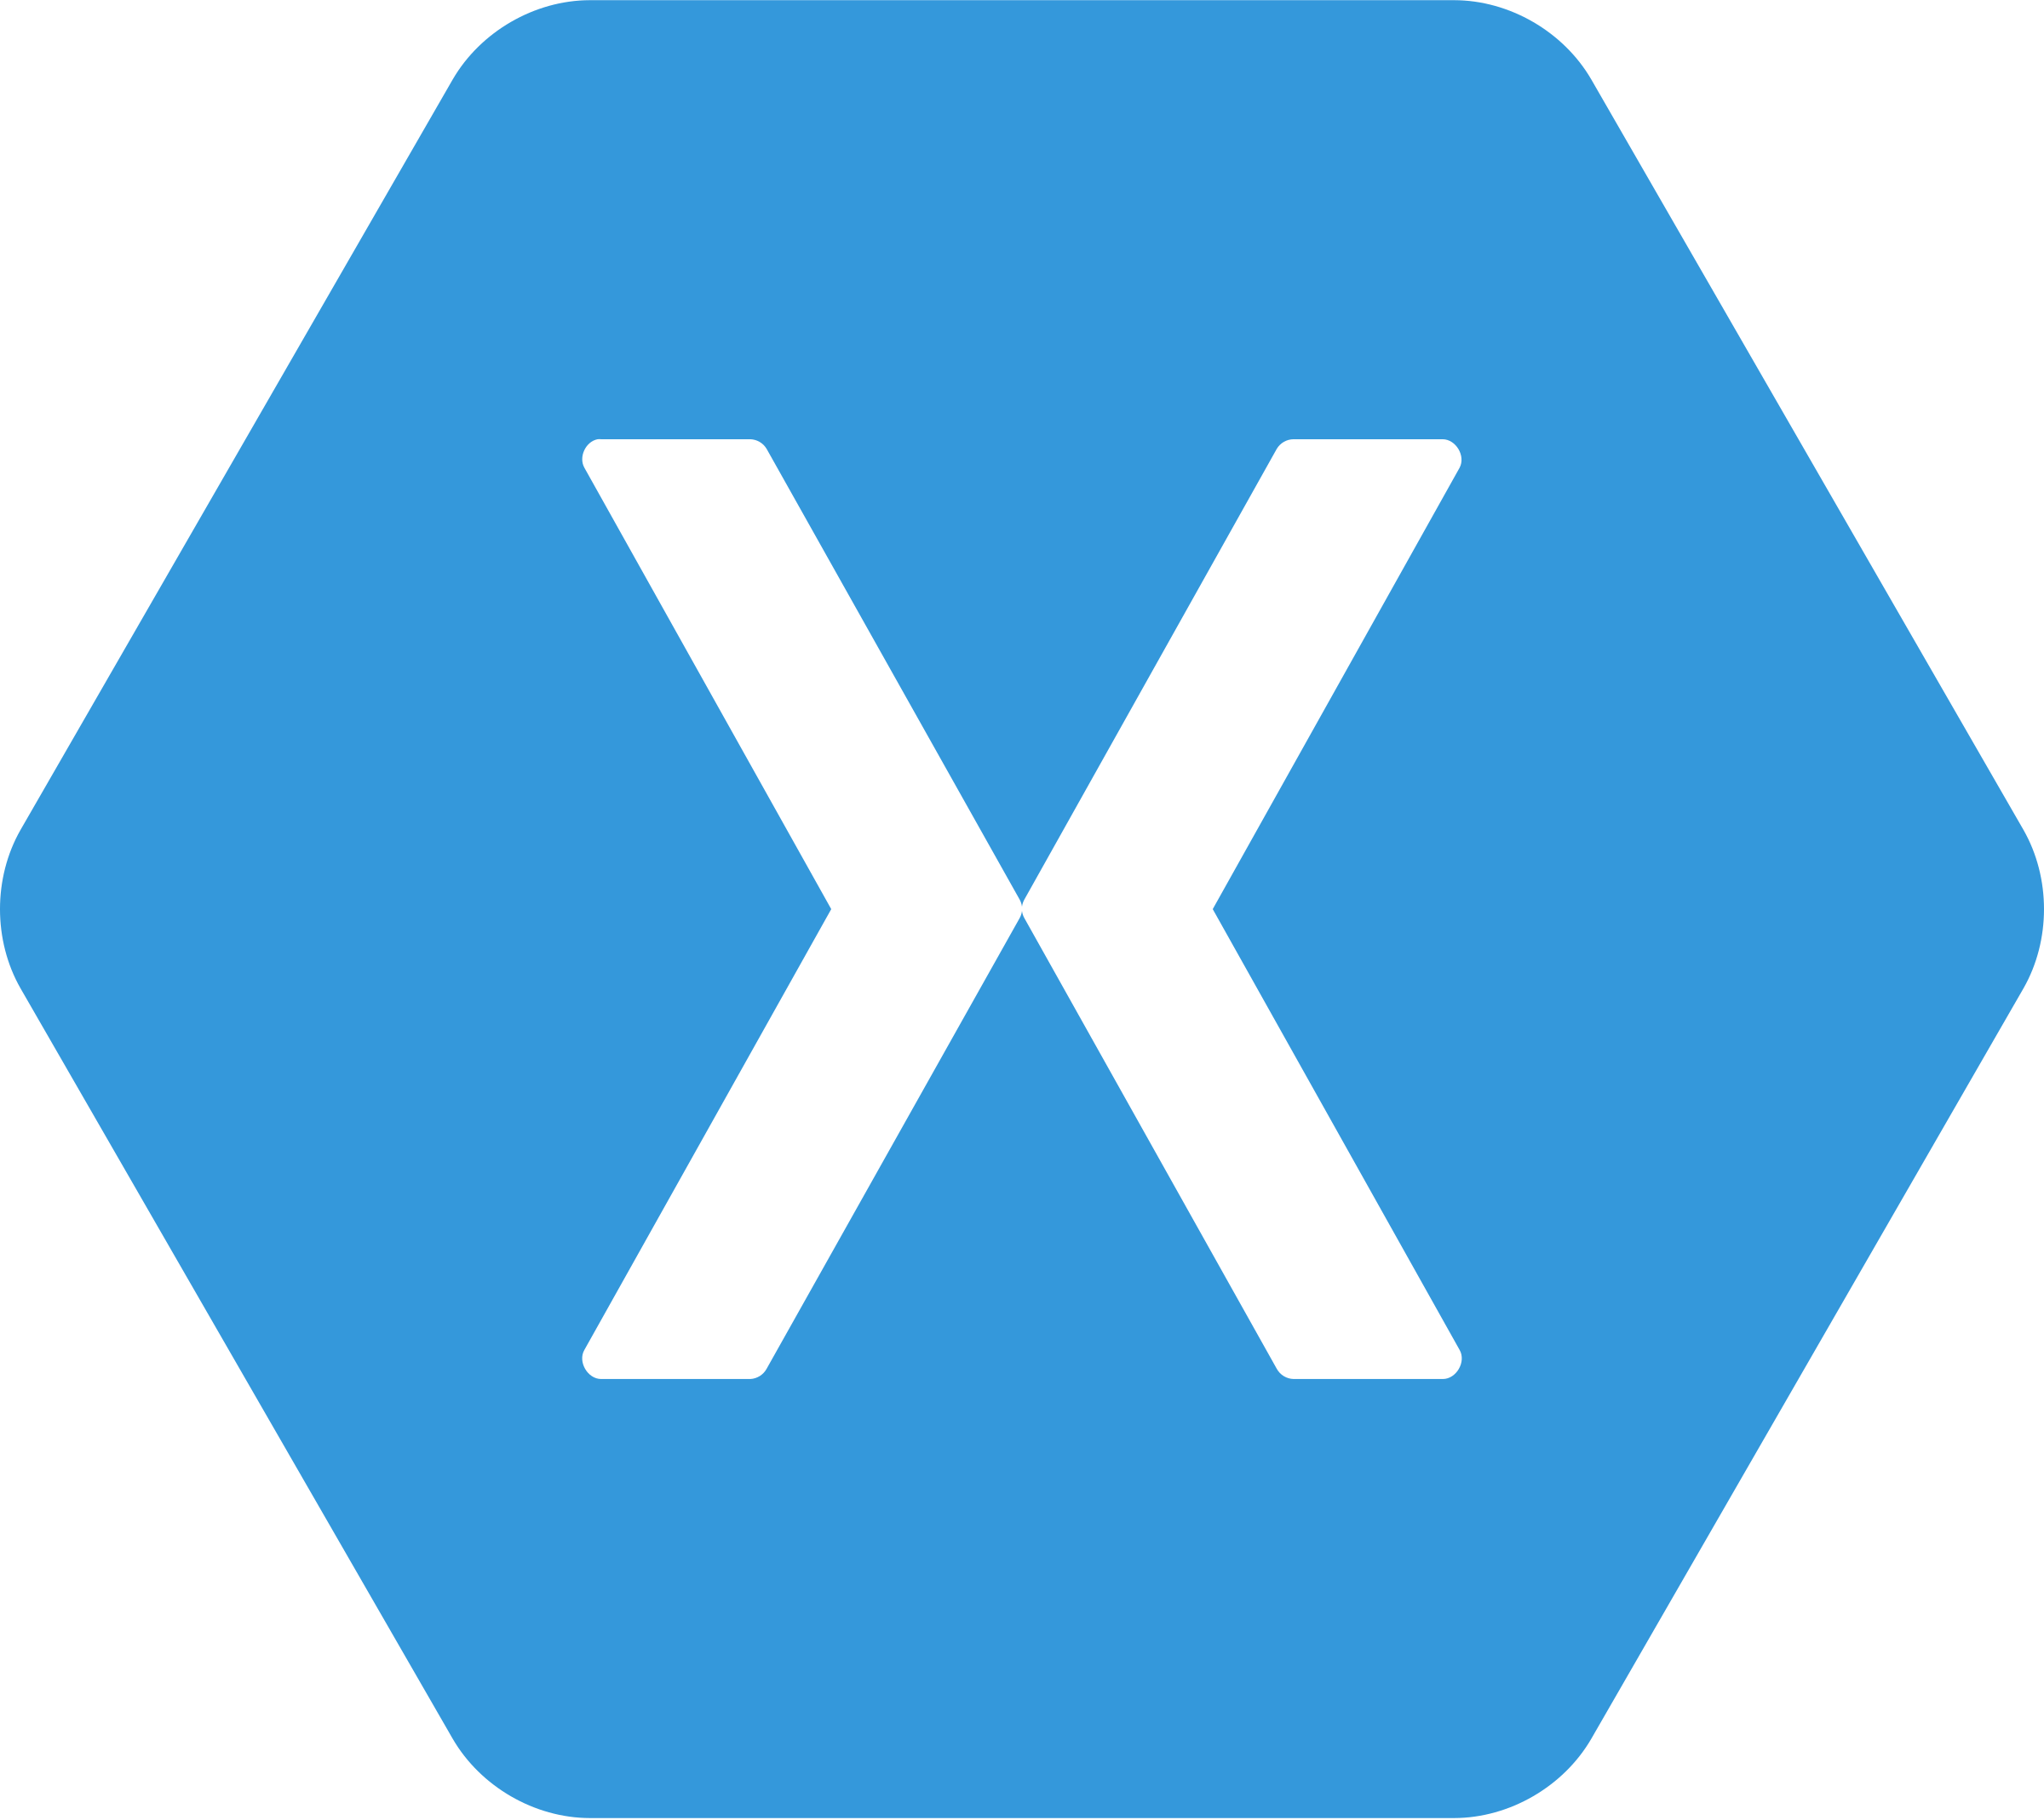




Slide 6
An open source app platform
from Microsoft for
building modern & performant
iOS, Android, macOS,
watchOS, & tvOS apps with .NET.

Slide 7

Xamarin
iOS C# UI
Android C# UI
Windows C# UI
Shared C# Logic
Shared C# codebase • 100% native API access • High performance

Slide 8
Xamarin
+ Xamarin.Forms
iOS C# UI
Android C# UI
Windows C# UI
Xamarin.Forms
Shared C# Logic
Shared C# Logic
Traditional Xamarin approach
With Xamarin.Forms: More code-sharing, all native

Slide 10
How do I architect my app?
Serverless, the platform for cloud native apps
On-Premises
IaaS
PaaS
Serverless
The “evolution” of application platforms
Notes:
Serverless takes us to the ultimate cloud native experience: we simply focus on code. It doesn’t mean there is no server, because we still need to run on infrastructure, but the infrastructure is further abstracted so there is less server in our scope of responsibility and more code. We focus on what is unique for our business and spend more time on innovation, less time on answering the myriad questions that exist with the previous phases. Serverless is cloud native. But what does that really mean?
Think of this as a virtual machine in the cloud. You’re still responsible for the server’s software, keeping it up to date, and its backups; as well as the hardware specifications of the VM. But now you’re free of any physical hardware maintenance. And of course, you still need to write/host your applications and install whatever supporting software on the server that’s needed.
This is one level of abstraction higher than IaaS - the cloud provider takes care of the server, the supporting software, and the hardware. You host your applications on top of that pre-existing setup or platform. You do still take care of some basic server configuration and things like scaling.
Serverless one step further – don’t even care about the platform or scaling. Just care about application logic.

Slide 11

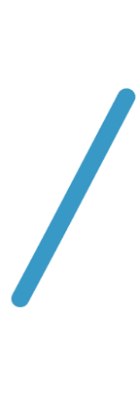


Introducing Functions
Code
Azure Functions
Events
Notes:
The first example you saw was functions. Functions are literally code and events. And now I’ve revealed a carefully guarded secret: you know where the functions logo came from!

Slide 12
Functions secret sauce: triggers and bindings
Triggers
Blob Storage
Cosmos DB
Event Hub
HTTP
Queues
Service Bus
Timer
Webhook
Bindings
File
Table
Excel
OneDrive
Email
Mobile app
Notification
More…
Notes:
Although functions are great because they run at scale and only bill when they are active, the “secret sauce” is in triggers and bindings. This is what made it so easy to access the data from table storage and respond to a web event. Instead of standing up a web server, we simply wrote code that responded to a web trigger and were passed a class with all of the information we needed. Instead of scanning for a connection string, opening a database connection, and navigating to table, our binding passed us a class that was already primed to interact with table storage. There are dozens of triggers and bindings available and you can write your extensions as well.

Slide 13
Scenarios
Every 15 minutes
Find and clean invalid data
Clean table
File added to Blob Storage
Transform CSV to datarows
Power BI
Chart graphic
Notes:
Here are some of the scenarios we see serverless being used for. Have you ever had to find a scheduling service or install a special service just to run a job at a regular interval? You can trigger functions with a timer trigger and do things like purge expired web sessions from a table. Another common scenario is to trigger a function based on a blob storage event. For example, an ETL process may upload a CSV file that is then parsed, transformed into database rows and then analyzed with a Power BI dashboard.

Slide 14
Scenarios
Forecast needed
r
Retrieves from 3rd party service
Forecast returned
PP
r
Notes:
Another scenario might trigger from a photograph that is uploaded and this triggers code that automatically generates thumbnails. The last scenario is my personal favorite. You visit a web page, the page calls a function with your user profile and this gathers all of the data collected to deliver a personalized ad. This is why you do a web search for smart thermostat and suddenly see IoT ads everywhere you visit.

Slide 15
Singing in the Rain …
… ADDING COMPUTE WITH AZURE FUNCTIONS

Slide 17














Slide 19
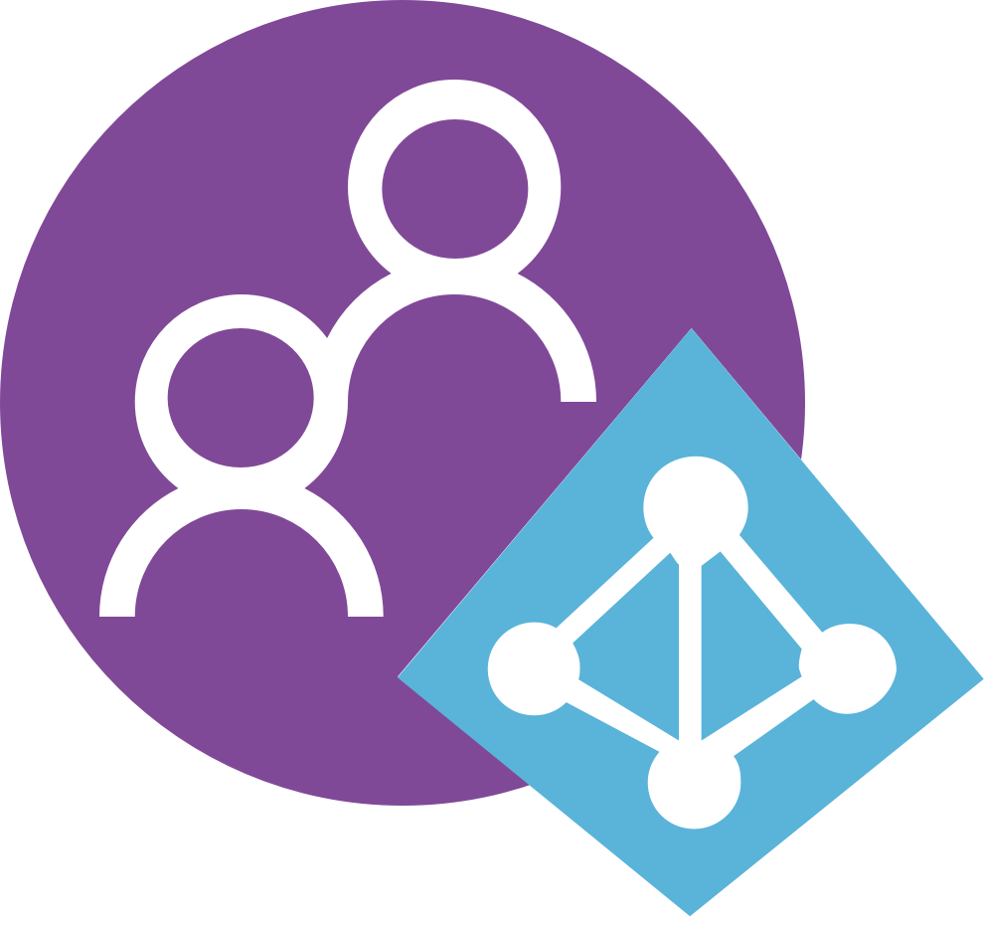

Azure
Active Directory B2C
Visual Studio
App Center
Notes:
# Cover the current relationship we have with B2C

Slide 20

App Center’s focus on creating simple user experiences
Microsoft Authentication Library (MSAL):
Displays login UI (B2C default or developer custom)
Interacts with B2C to manage credentials, expiration, etc.
Robust and reliable capabilities of Azure AD B2C
What is App Center Auth?
Simplified in-app B2C config through App Center SDK
Azure AD B2C
Invokes 3rd-party identity provider (IdP) authentication process
Manages User name & password for custom auth scenarios.
App Center SDK wrapper around MSAL

Slide 21
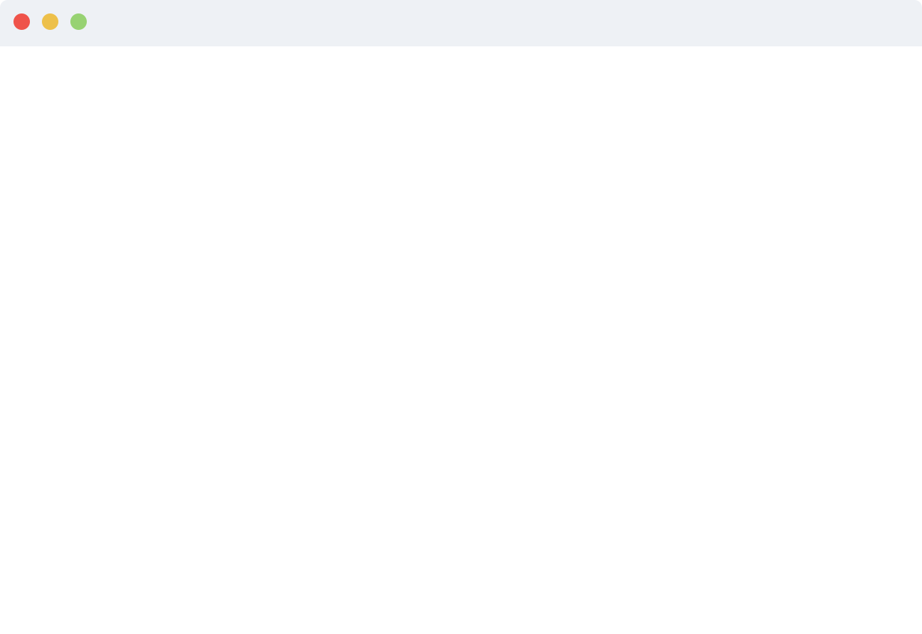

async void SignIn() { try { // Sign-in succeeded. UserInformation userInfo = await Auth.SignInAsync(); } catch (Exception e) { // Do something with sign in failure. } }
2
Step 2 Show Sign-in UI

Slide 22
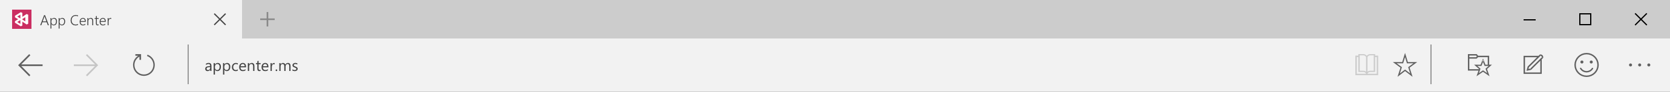
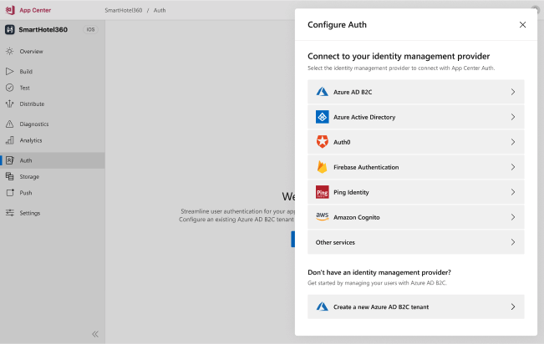
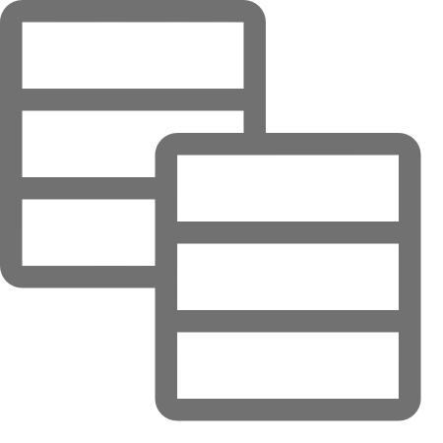
Auth Third Party Identity Providers

Slide 23
Azure
Cosmos DB
Visual Studio
App Center

Slide 24
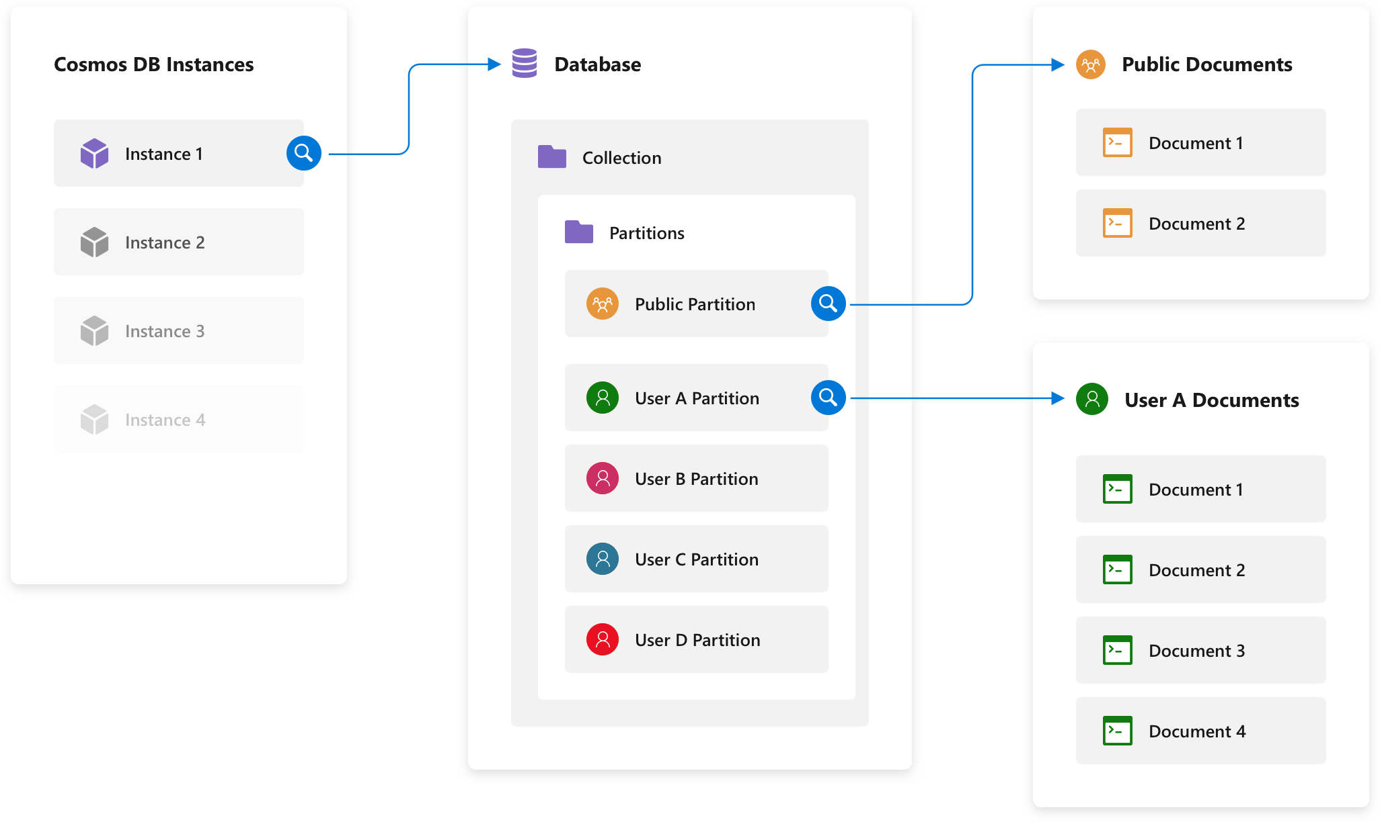

Slide 25
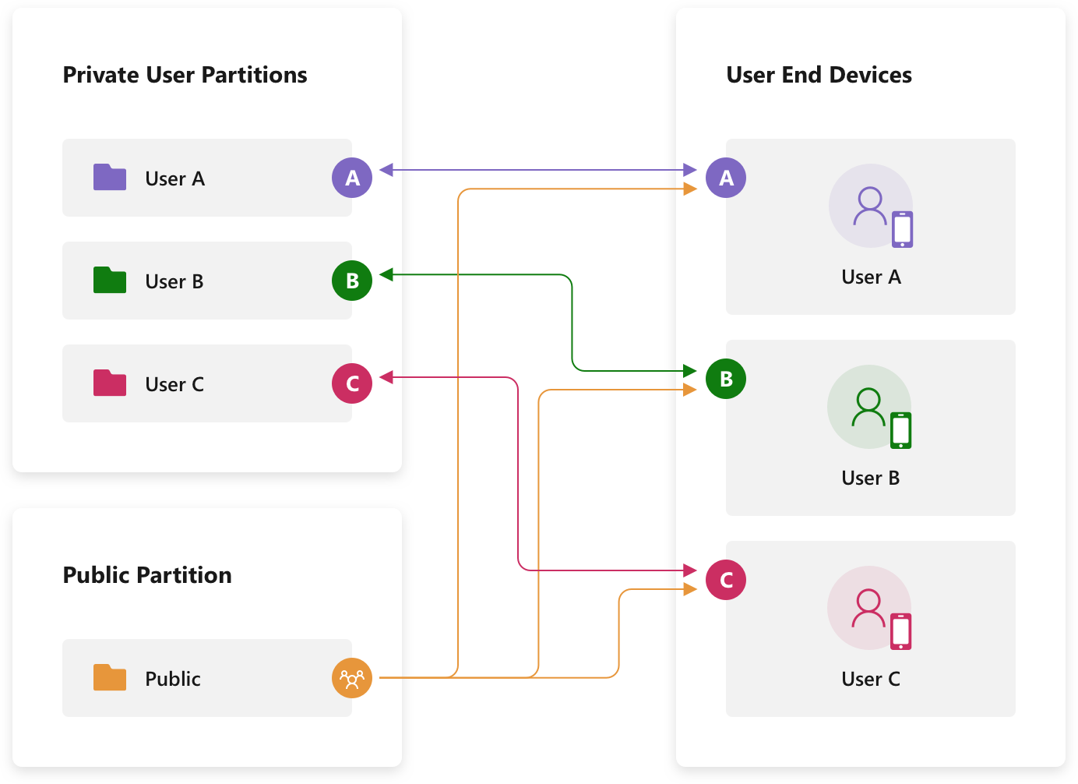

Slide 26
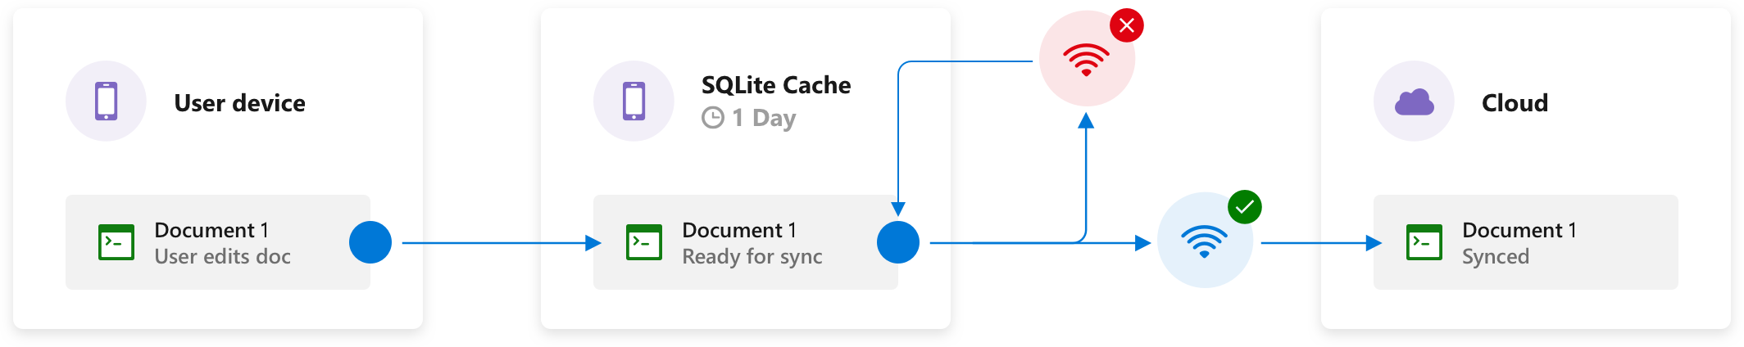
Offline Scenarios - Write
Offline writes cached
Reads: latest cached document
Default Time To Live: 1 day.
Can customize this using WriteOptions() or ReadOptions() in the SDK

Slide 27
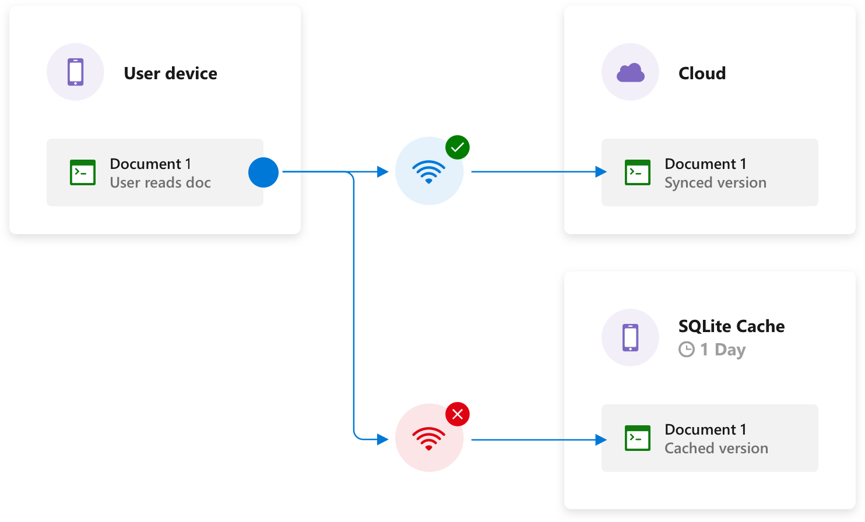
Offline Scenarios - Read
Offline writes cached
Reads: latest cached document
Default Time To Live: 1 day.
Can customize this using WriteOptions() or ReadOptions() in the SDK

Slide 28
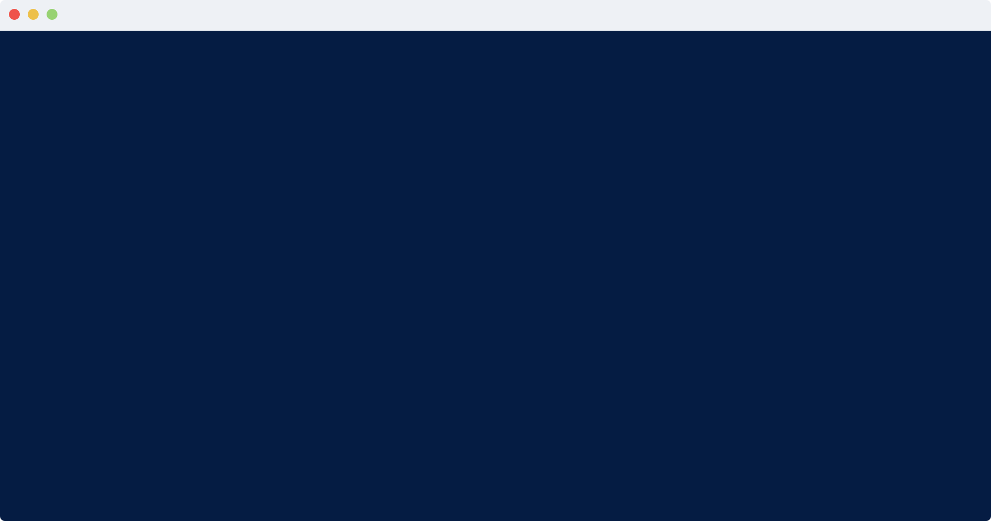
// Define Model
public class User {
private String id;
private String name;
private String email;
private String phoneNumber;
}
// Create Object
User user = new User(“1”, "Jim", "Jim@appcenter.ms", "+1(855)-555-5555");
// Create Document
Data.create(user.id, user, User.class, DefaultPartitions.USER_DOCUMENTS);
// Delete Document
Data.delete(user.id, DefaultPartitions.USER_DOCUMENTS);

Slide 29
// Get Object List
var user = await Data.ListAsync<User>(DefaultPartitions.UserDocuments);
// Get Object
var docs = await Data.ReadAsync<User>(user.Id, DefaultPartitions.UserDocuments);
// Upsert
await Data.ReplaceAsync(user.Id, user, DefaultPartitions.UserDocuments);

Slide 30
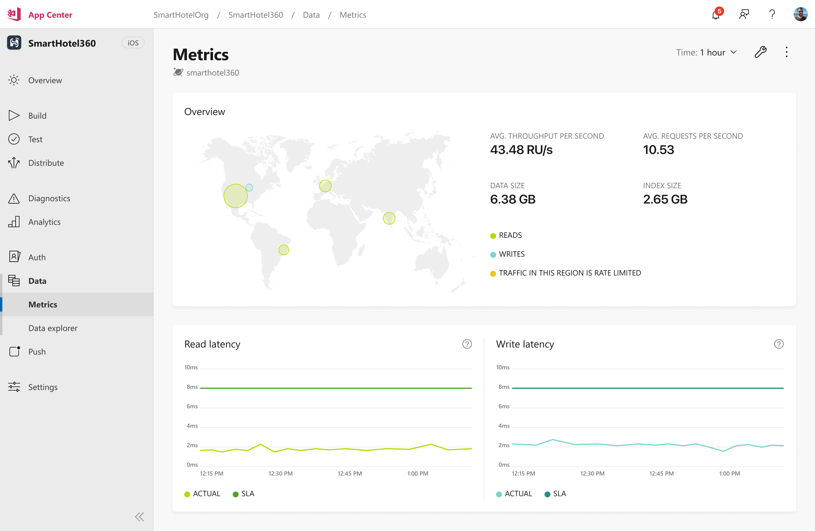
Data Metrics

Slide 31
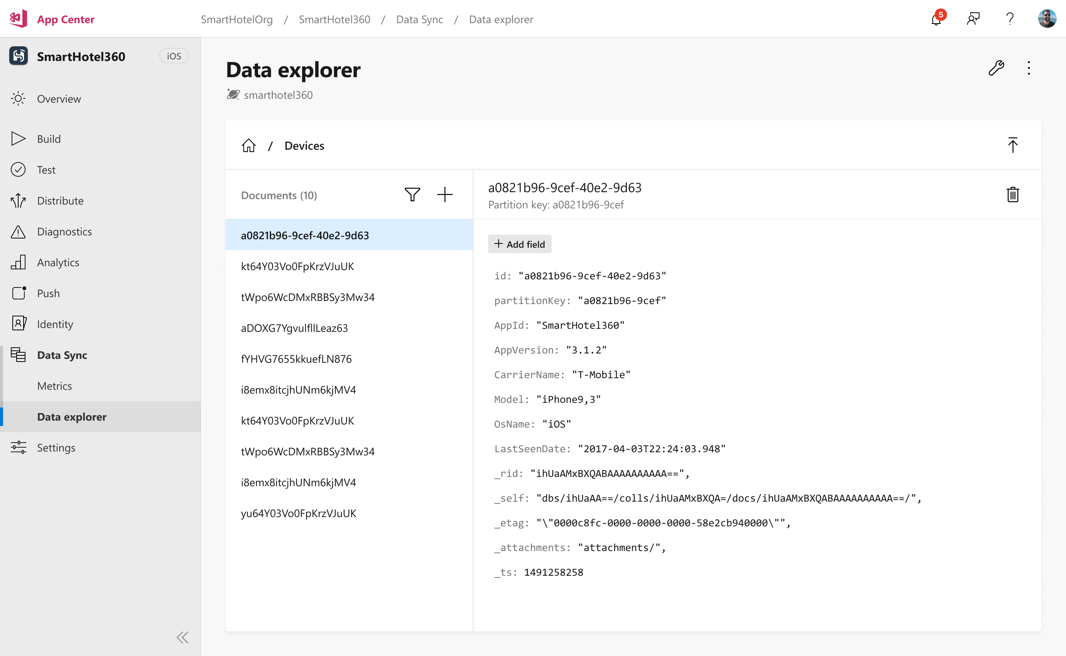
Data Browser

Slide 32

Data Free Tier
This slide should be a celebration. Any thoughts?

Slide 33
Walking on Sunshine …
… AUTH AND DATA WITH APP CENTER

Slide 34
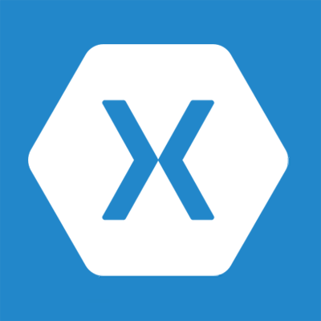

Summary
Xamarin – cross platform mobile apps
Azure Functions – serverless backend
App Center – mobile backend as a service

Slide 35



Learn more!
aka.ms/dotnet-conf-xam
aka.ms/dotnet-conf-func
aka.ms/dotnet-conf-auth
aka.ms/dotnet-conf-data
aka.ms/dotnet-conf-amazing
@codemillmatt

Slide 36
Build Amazing Cloud Connected Apps with Xamarin, Azure, and App Center
Matt Soucoup – Sr Cloud Advocate
@codemillmatt

